Slide 1
A Simple Portfolio Management

Slide 2
Outline
Motivation
Methodology
Deployed Architecture
Results
Limitation
Future works

Slide 3
Motivations
Investors should know what and why they invest
Investors need a tool to construct and optimize portfolio for hedging

Slide 4
Problem Statement
Investors mainly focus on technical analysis and fundamental analysis for trading
There is no tool with new technique that can be monitored performance in large scale for these purposes at this time

Slide 5
Goals of this work
Develop a trading platform that we can track its performance automatically in large scale
Develop an approach that can dynamically adopt change of environment
Help investors trading with more information by creating a friendly tool

Slide 6
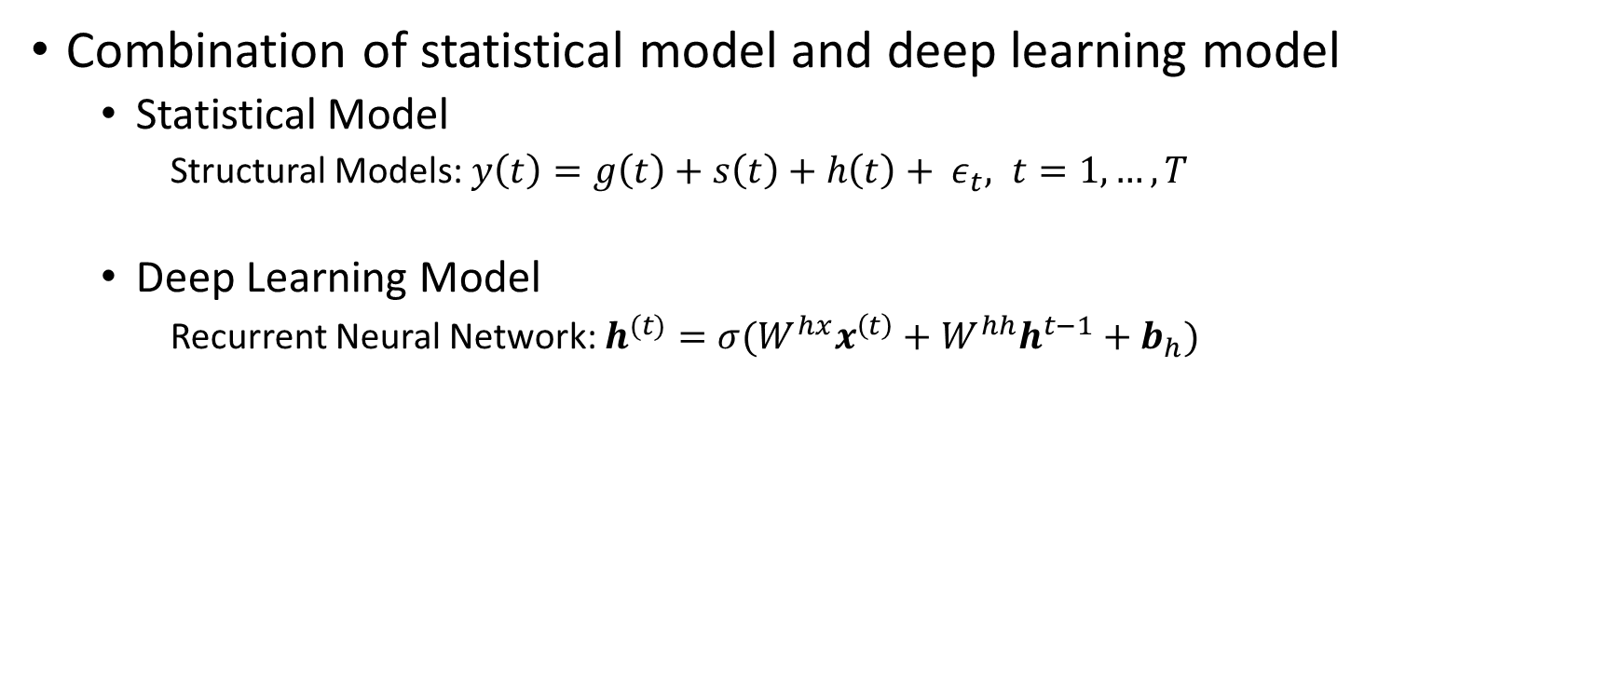
Methodology
Combination of statistical model and deep learning model
Statistical Model
Structural Models: $y\left(t\right)=g\left(t\right)+s\left(t\right)+h\left(t\right)+ ε_{t}, t=1,…, T$
Deep Learning Model
Recurrent Neural Network: $h^{(t)}=σ(W^{hx}x^{\left(t\right)}+W^{hh}h^{t−1}+b_{h})$

Slide 7
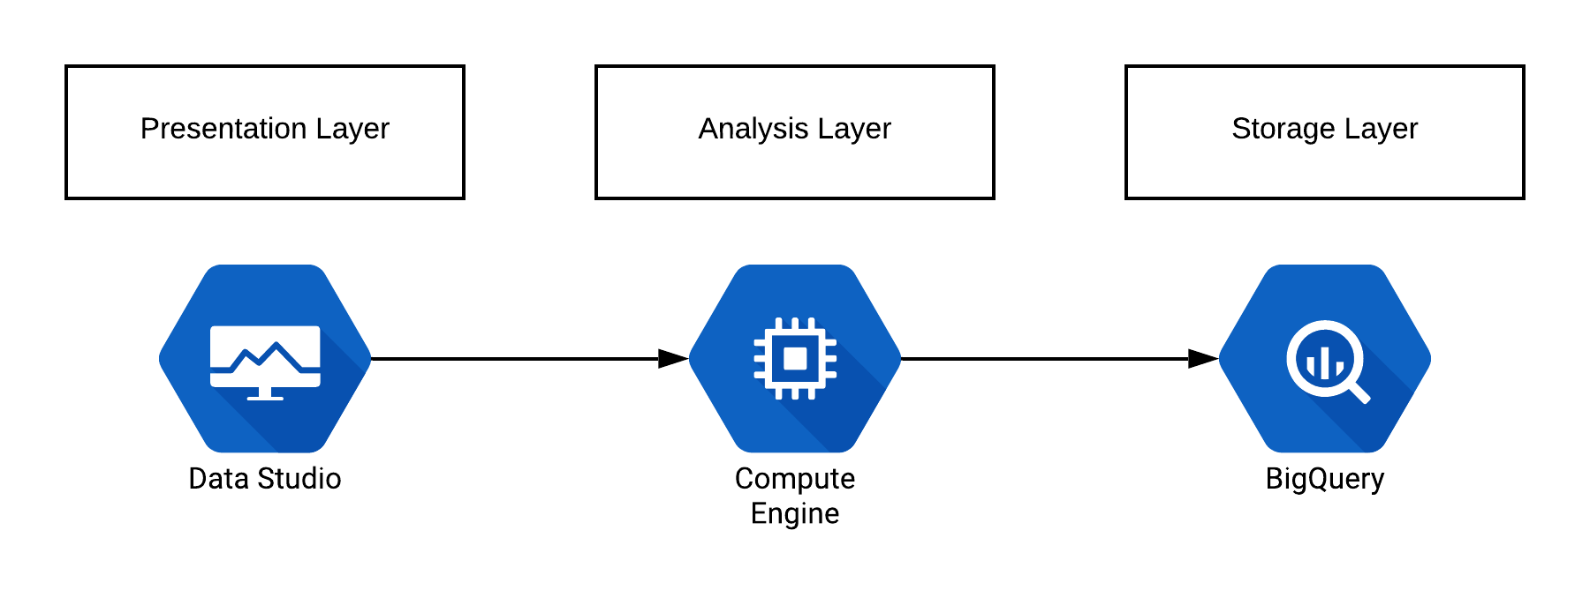
Deployed Architecture
Figure 1: Current Deployment

Slide 8
Deployed Architecture
Daily update stock price data
Daily analyze and predict future price of stocks
Daily calculate current and future return of portfolio
Suggest stocks for portfolio construction and optimization
Figure 2: Current Deployment

Slide 9
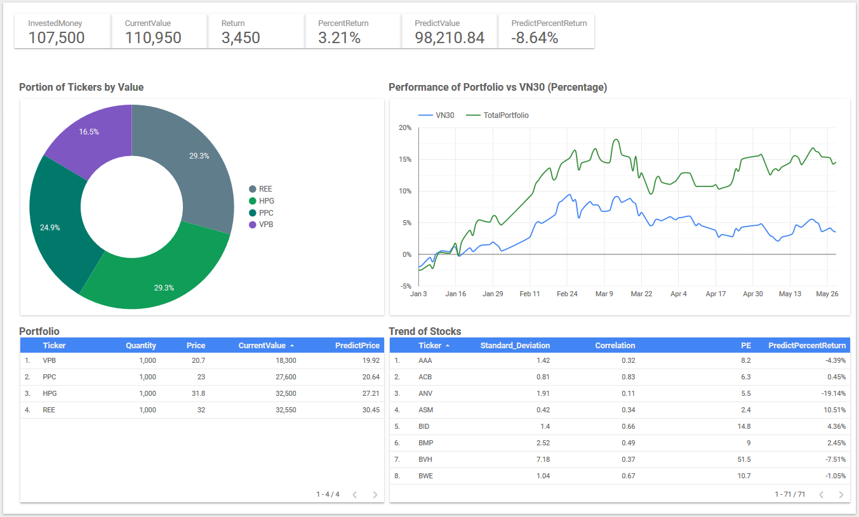
Results
Figure 3: Visualize of analyzed stocks

Slide 10
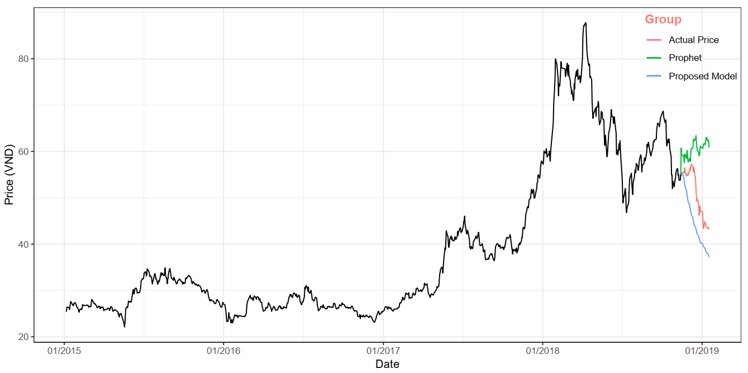
Results
Figure 4: 45-day forecast of HCM

Slide 11
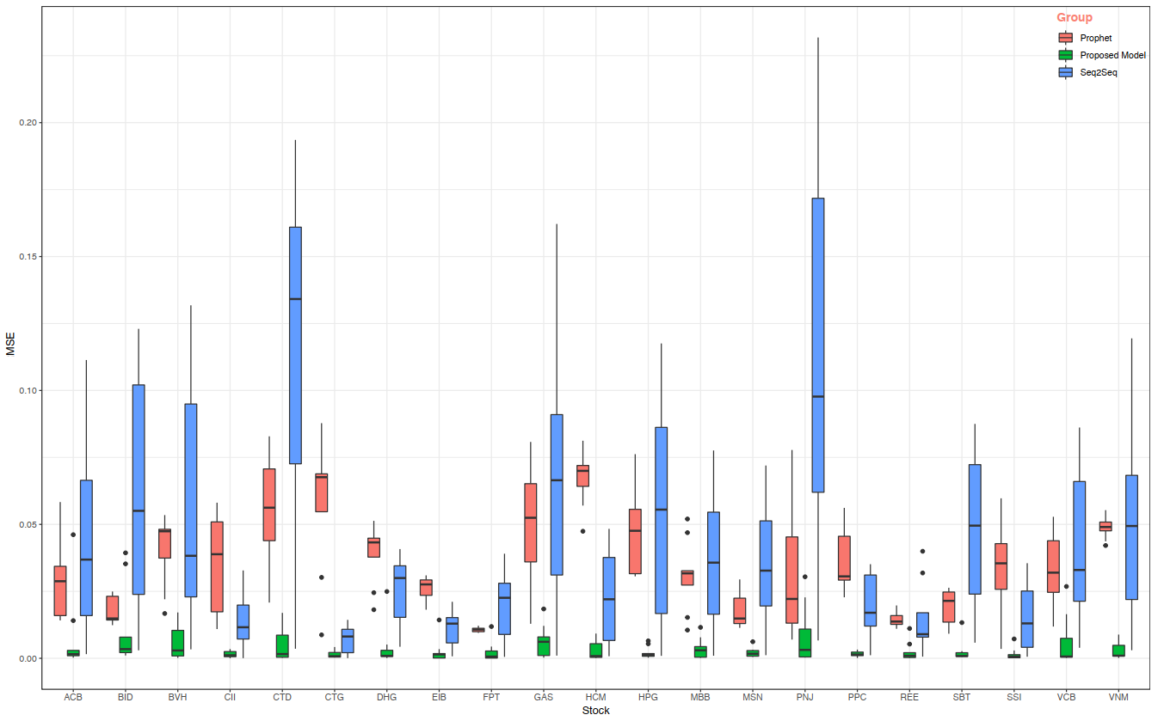
Results
Figure 4: Error of out-of-sample forecasts in log-scale

Slide 12
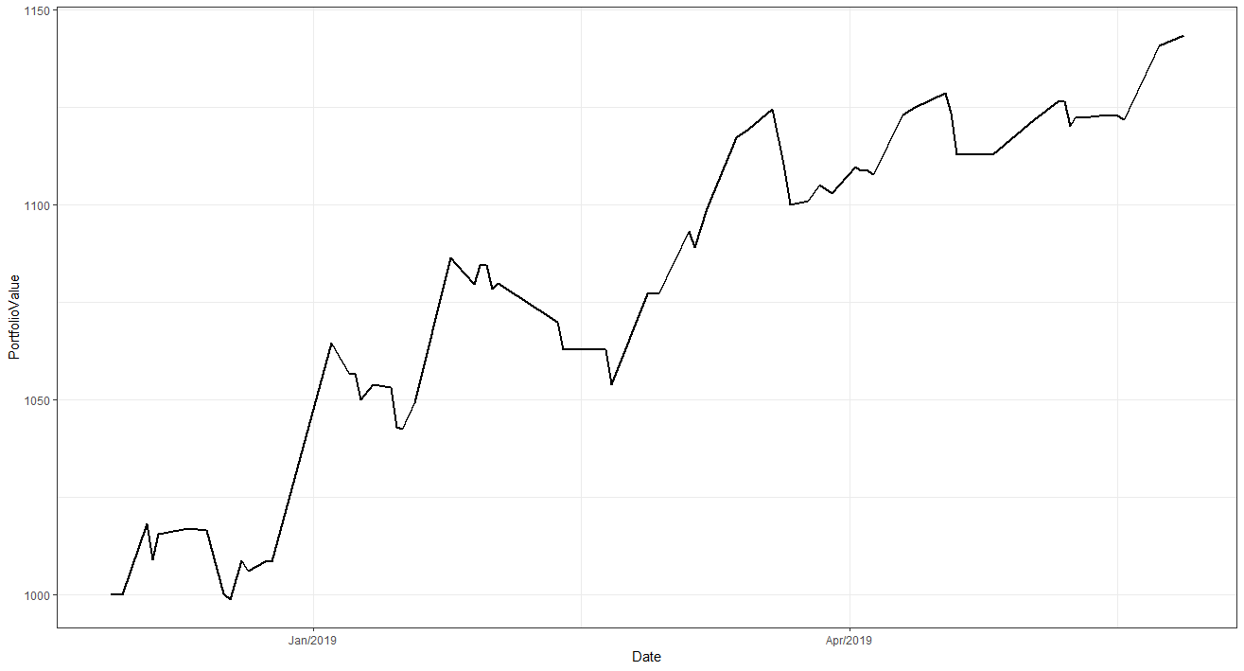
Results
Figure 4: Daily portfolio value of VN30F1M trading

Slide 13
Limitations
Technology:
Sequential training model
Cannot monitor model performance after deployment
Manual create portfolio tracking for every new user
Cannot visualize with full experiment for mobile users
Inefficient operation cost
Trading Model:
Highly depend on trend detection
High computational cost
Cannot compute confidence of prediction

Slide 14
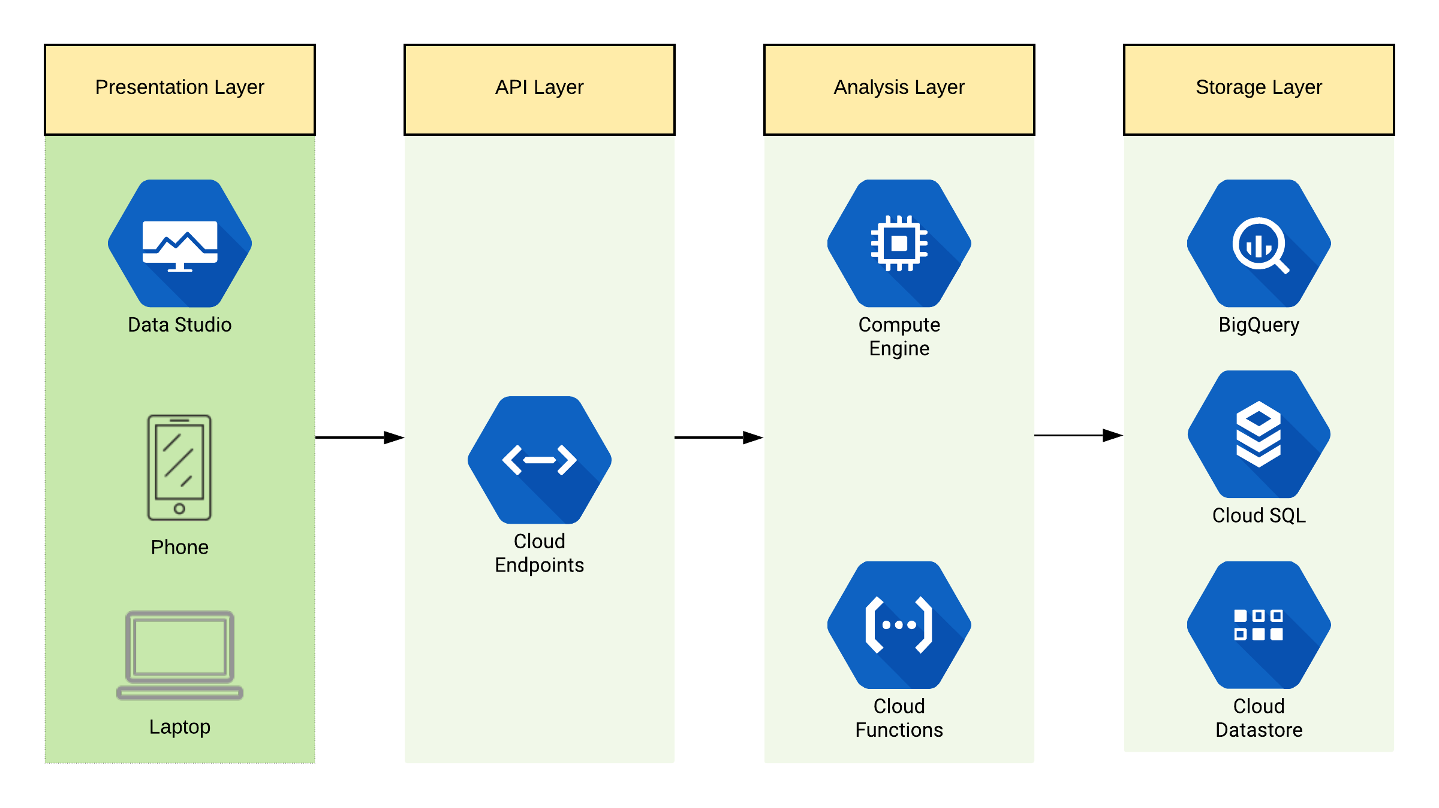
Future Architecture
Figure 1: Future Deployment

Slide 15
Future works
Provide iOS app for mobile users
Leverage Cloud Functions to save cost

